Slide 1




Nithish Kumar G

Slide 2


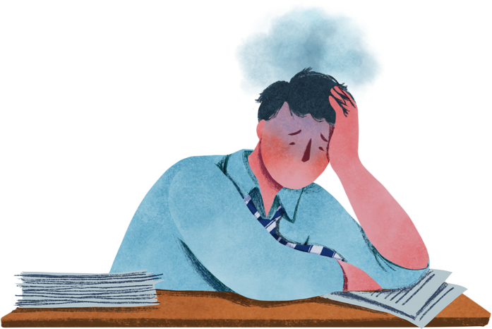

PROBLEM STATEMENT
In today's fast-paced and highly digitalized world, many individuals find themselves increasingly isolated, which significantly impacts their mental health. Despite growing awareness, there is still a considerable gap in understanding, addressing, and supporting mental well-being.

Slide 3
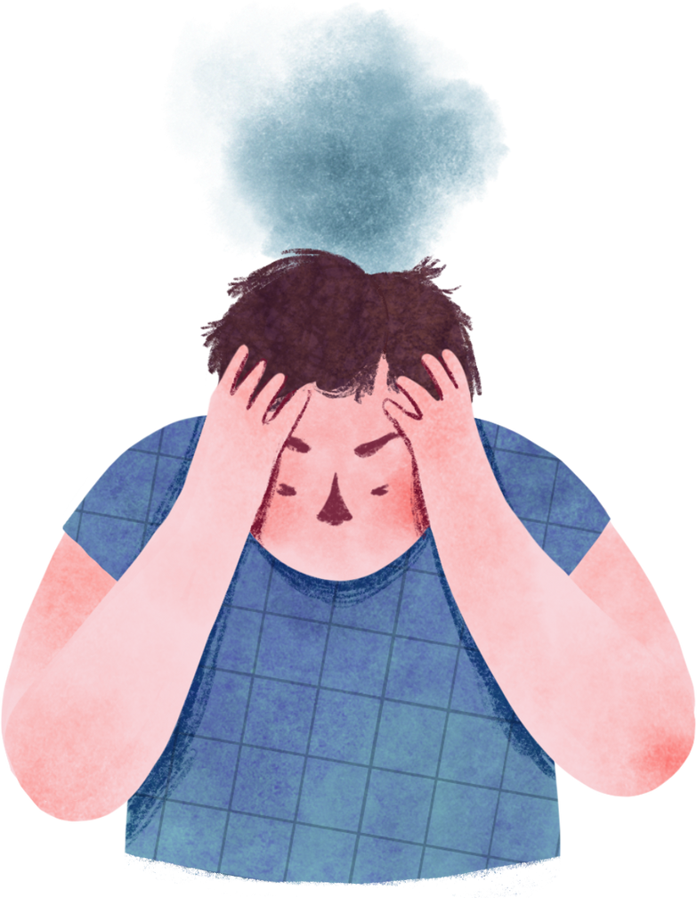
Mental health today

Slide 4
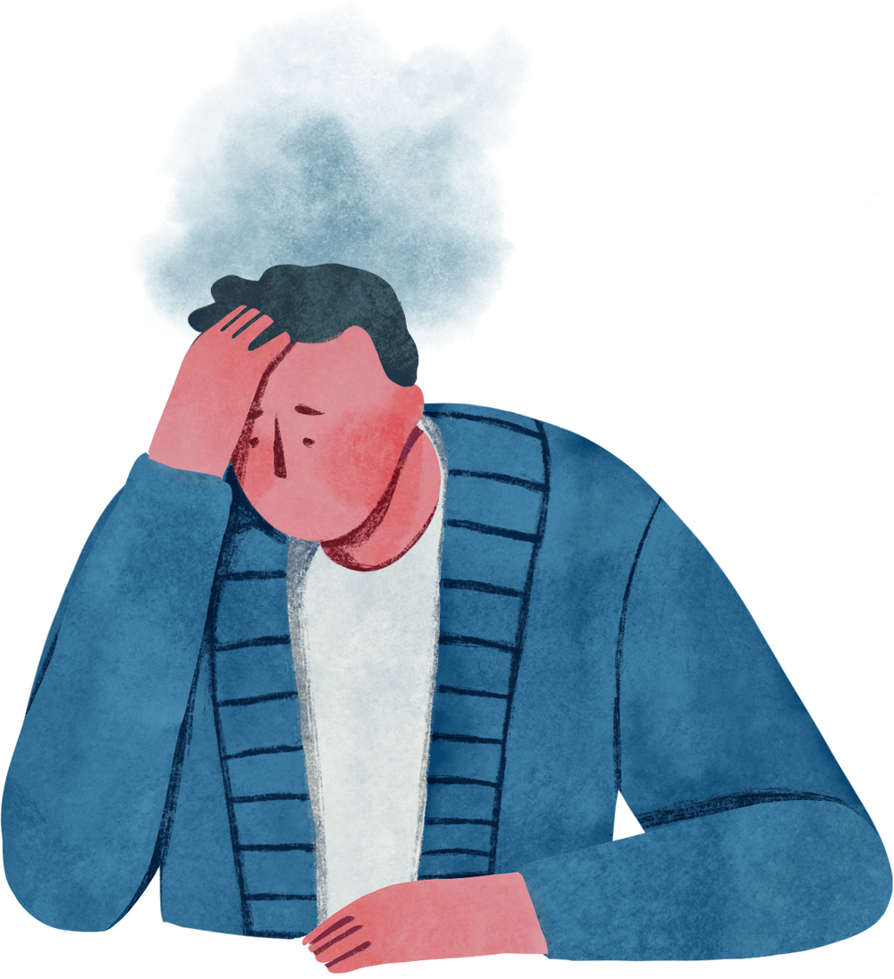
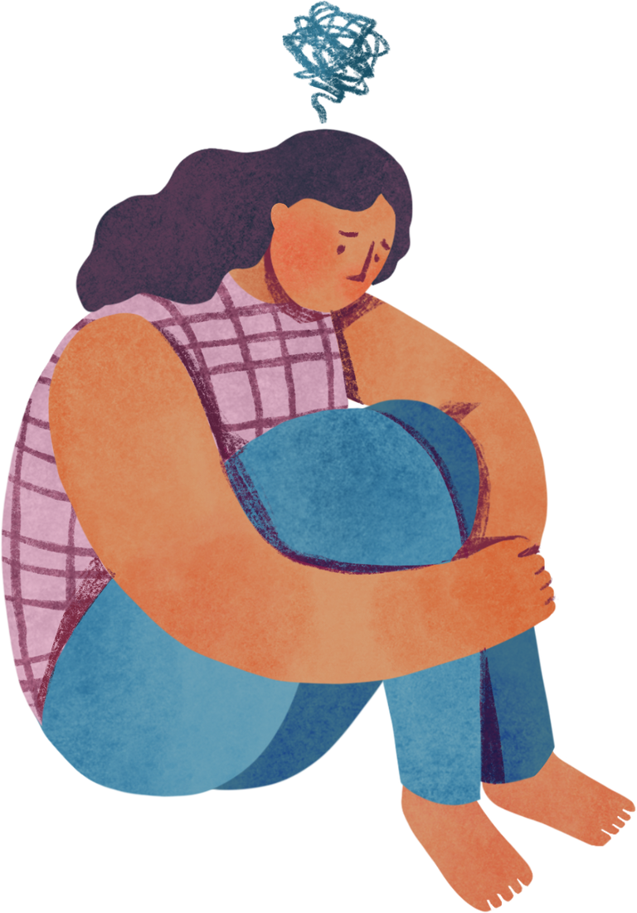
"We need to understand what happens to us inside"
What to do now?

Slide 5
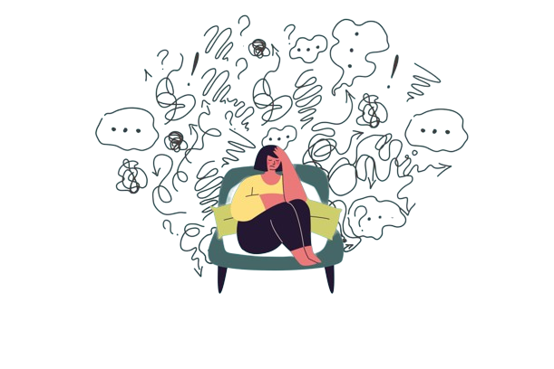
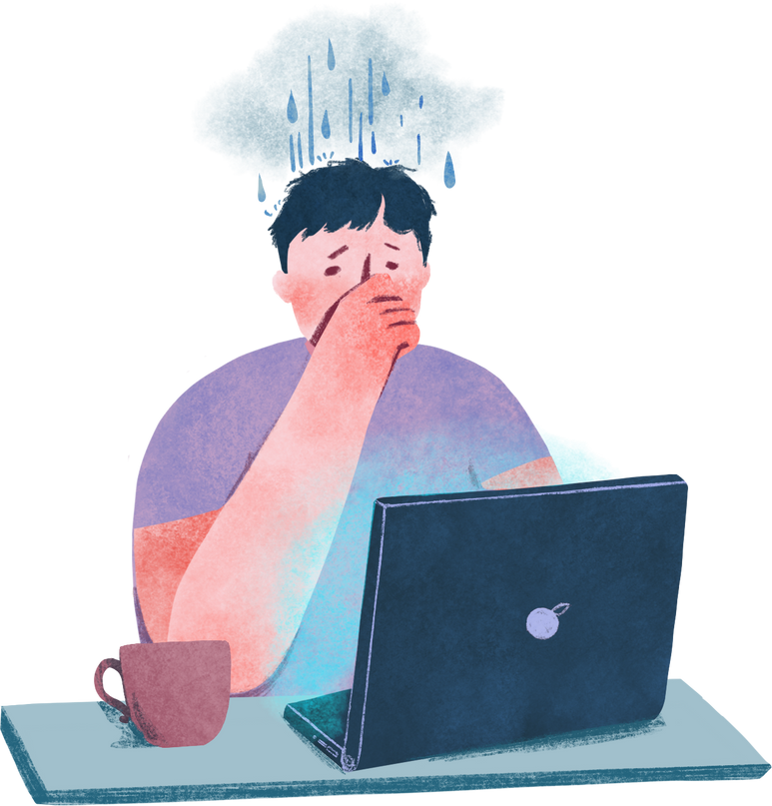
"Anxiety is a real problem in our society"

Slide 6

SOLUTION
The idea of this project is to address the pervasive issue of social isolation and the consequent neglect of mental health by developing an innovative, user-friendly website. This website will serve as a comprehensive resource hub aimed at promoting mental wellness, encouraging social interactions, and providing accessible mental health resources.

Slide 7
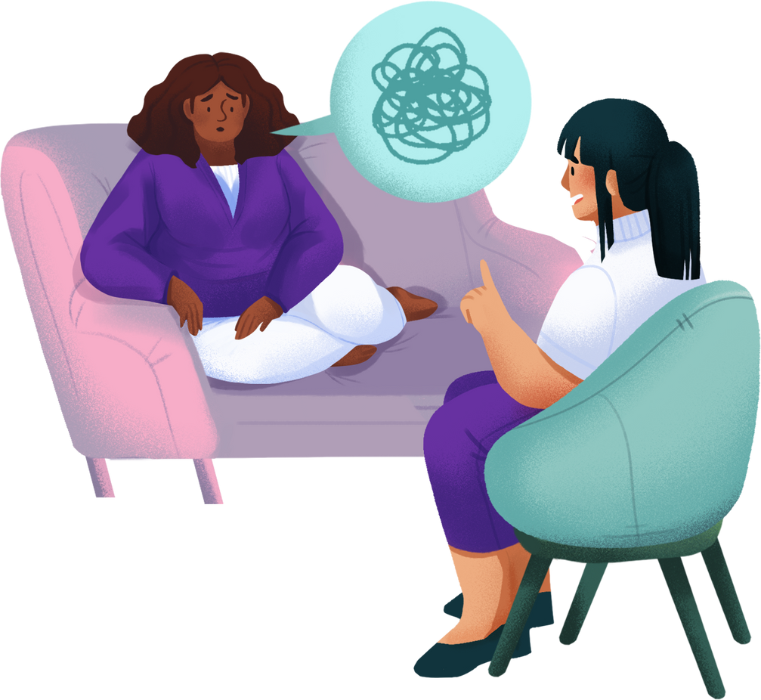
Self-Awareness:
First step in therapy
Management of stress and anxiety

Slide 8
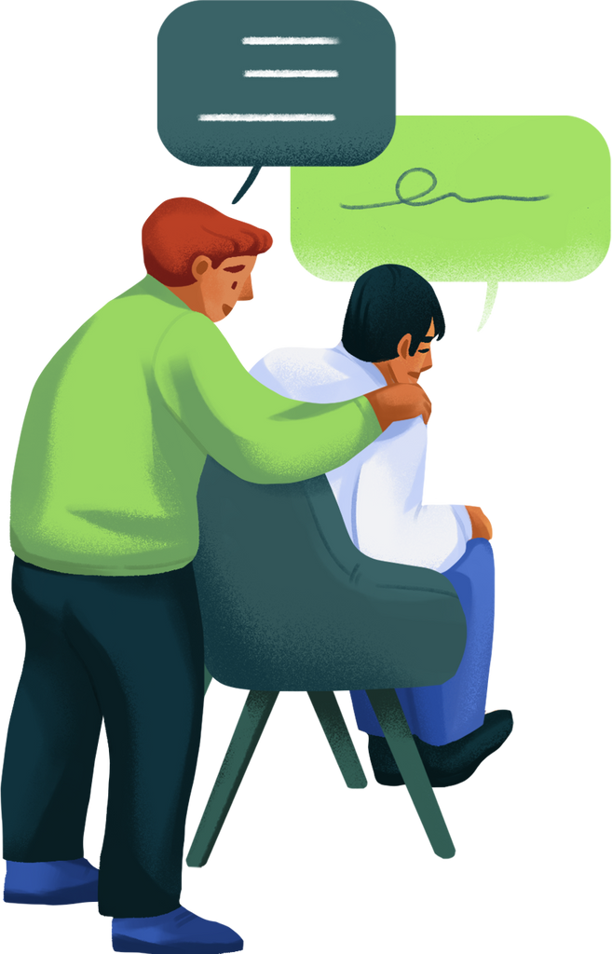
Overcoming internal blockages and barriers
Assertive communication and healthy relationships

Slide 9

View Website

Slide 10





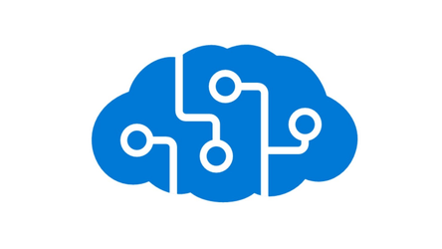


Azure Core Services
Azure AI Services
AI Language Studio
Customer Questioning Answering(QnA)

Slide 11
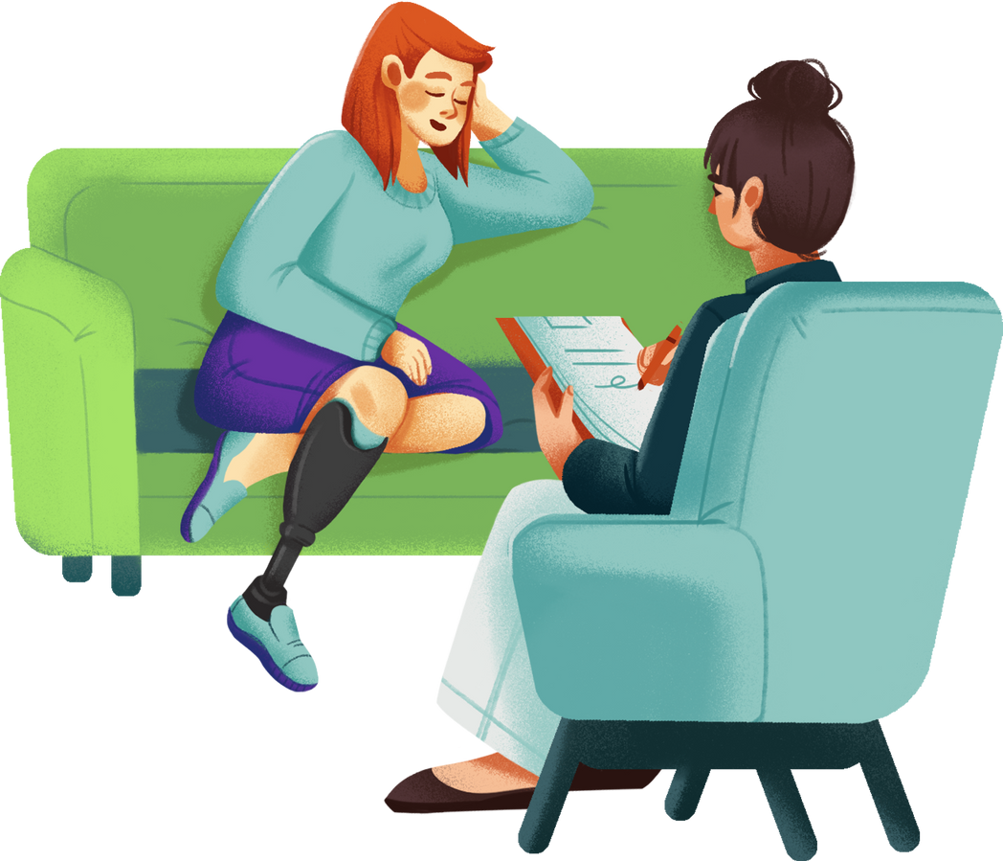
Thank you very much!
Presented by Nithish Kumar

